Slide 1
Final Project
Group 13

Slide 2
Group
Mason Murray-Cooper
Brice Pridgen
Toktam Mohammadnejad
Ricardo Luiz Moreira Paschoeto

Slide 3
Resume
The robot will navigate on the map and searching for three vendors – Broccoli, Pizza, Hot-Dog. We can operate the robot manually or set a list containing vendors' sequence to visit sequentially; for this, we worked on the A* algorithm to solve multiple sequential paths.

Slide 4
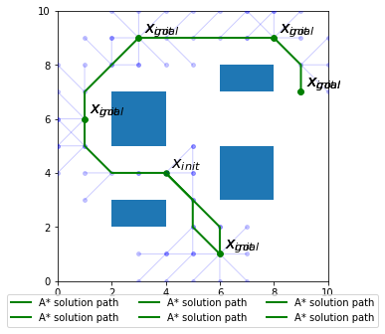
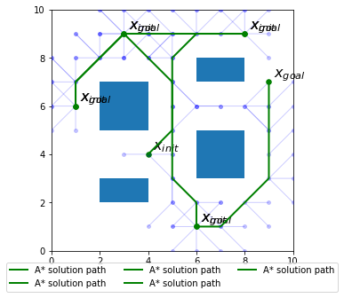
Multi A* algorithm example

Slide 5
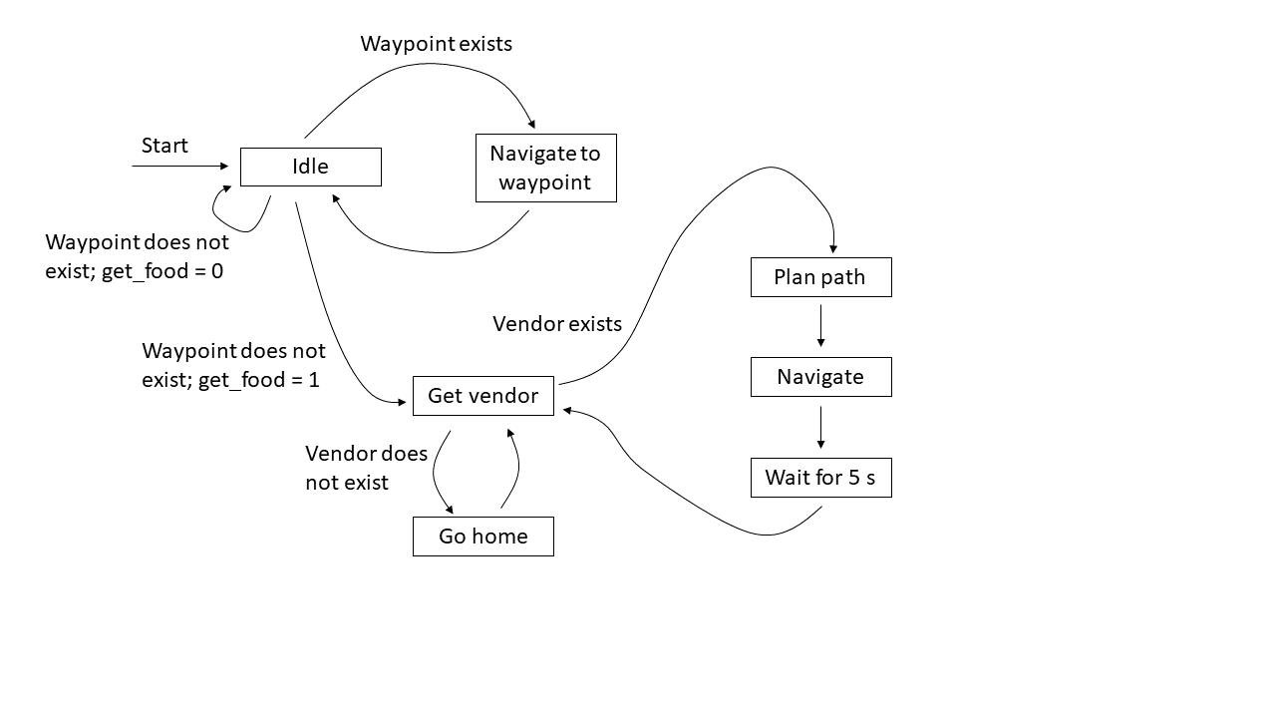
FSM

Slide 6
Extensions
Stop at stop signals - The world will have at least three stop signs. When the robot comes to a stop sign, it will stop for five seconds and then continue on its planned path.
Plan an optimal path - The robot will plan the shortest time route between multiple vendors, accounting for the time to stop at stop signs.
Recognize a Dog - The robot will be on the lookout for Dog around the world and doing something fun.

